Slide 1
Health TechNet
May 20, 2016
Nathan M. Bays, J.D.
General Counsel, The Health Management Academy
Executive Director, The Academy Advisors
Caitlin Greenbaum, MPH
Director, Health Policy & Strategy
The Health Management Academy
MAY 2016

Slide 2
Overview
Delivery Reform & Value-Based Payment Models
MACRA Overview
MACRA: “MIPS,” “APMs” and the new Medicare physician payment structure
MACRA strategic considerations
Confidential: This material is intended solely for informational purposes

Slide 3
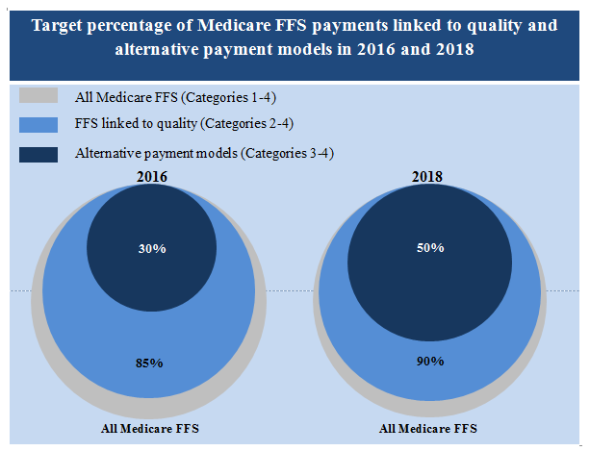
CMS Value Initiative Goals
2016 Value-based Payment Goal
30% Medicare payments in alternative payment models
85% of Medicare fee-for-service payments in VPB
2018 Value-based Payment Goal
50% Medicare payments in alternative payment models
90% Medicare fee-for-service payments in VPB
Confidential: This material is intended solely for informational purposes
Graphic Source: http://www.cms.gov/Newsroom/MediaReleaseDatabase/Fact-sheets/2015-Fact-sheets-items/2015-01-26-3.html
Notes:
http://www.cms.gov/Newsroom/MediaReleaseDatabase/Fact-sheets/2015-Fact-sheets-items/2015-01-26-3.html

Slide 4
SGR Repeal & Physician Value-Based Payments
Confidential: This material is intended solely for informational purposes

Slide 5
SGR Repeal: How It Changes Medicare Physician Payments
In April the methodology used to calculate physician payments for the Medicare program, also known as the “SGR” was repealed, and replaced with a new physician payment structure referred to as the “Quality Payment Program”
“Transition period” where the payment structure remains as it is today, although performance period impacting future payments begin in 2017
2017 Baseline Performance Year, 2019 Implementation: Physicians (or groups/virtual groups) elect to remain in fee-for-service subject to a new value-based regime (“MIPS”) or transition their practice toward risk-based models (“APMs”), and will be reimbursed differently under each track
Bottom line: assuming no changes, fee-for-service as it currently exists will substantially move toward “pay-for-performance” and economic incentives will drive physicians toward alternative payment models over time (“APMs”)
Confidential: This material is intended solely for informational purposes

Slide 6
MACRA Development/Implementation Timeline
Threshold Year for APM Eligibility
January
New Resource Use codes included in claims
~April
Proposed
Rule
~October
Final Rule
Threshold Year for Advanced APM Eligibility and MIPS Performance Year for 2019 Adjustments
First MIPS Adjustments & APM Incentives Applied
2016 | 2017 | 2018 | 2019
November
CMS releases list of MIPS measures & APM criteria
Confidential: This material is intended solely for informational purposes

Slide 7
Physician Payment Structure: The Next 10 Years
2015 | 2016 | 2017 | 2018 | 2019 | 2020 | 2021 | 2022 | 2023 | 2024 | 2025 | 2026+
Annual Updates In 2019, physicians elect to participate in one of two adjustment mechanisms: Merit Based Incentive System (“MIPS”) or Alternative Payment Model (“APM”) Programs
Jan-Jun 0% Jul-Dec 0.5% | 0.5% | 0.5% | 0.5% | 0.5% | 0% | 0% | 0% | 0% | 0% | 0% | MIPS: .25% Qualified APMs: .75%
Confidential: This material is intended solely for informational purposes
Source: The Health Management Academy

Slide 8
Merit-Based Incentive Payment (“MIPS”) Track
Measure Performance
Two year look-back – performance measurements begin in 2017 for 2019 adjustments
4 weighted categories – Quality, Cost/Resource Use, Advancing Care Information/EHR Use, Clinical Practice Improvement
Composite Score
Based on scores in each performance category, participants receive an annual composite score between 0-100
Threshold Comparison
Each clinician’s score will be compared against a performance threshold to determine payment adjustments
Performance threshold will based on the median of MIPS scores – competition among peers
Score will be publicly available via Physician Compare
Additional Adjustments
Adjustments are budget neutral – upward adjustment can be scaled up or down, with the scaling factor not to exceed 3 times the baseline adjustment
EHR MU, PQRS, and VBM – sunset in 2018, with certain measures incorporated into new MIPS categories
Additional exceptional performance adjustment offered to small number of best performers
Provider Eligibility Will Change Over Time
First two years – eligible providers include: MDs, PAs, NPs, clinical nurse
specialists, certified nurse anesthetists, and a group that includes such professionals
After 2021, HHS can determine other eligible professionals to subject to MIPS
Confidential: This material is intended solely for informational purposes

Slide 9
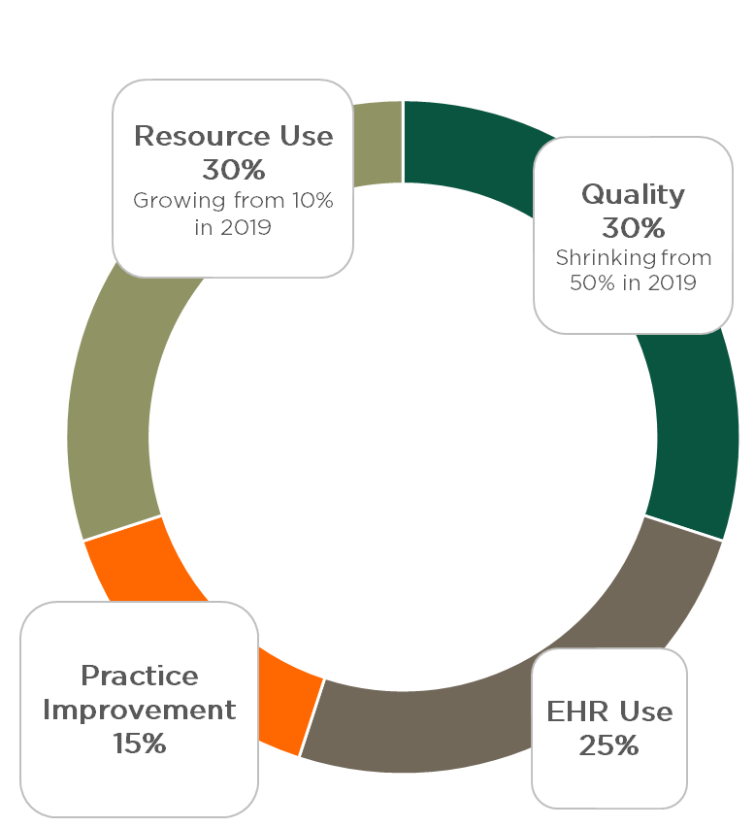
Components of MIPS Composite Score
Cost/Resource Use
Initial year CMS will calculate a score based on Medicare claims, no additional reporting
CMS will use over 40 episode-specific measures in the initial year
CMS will over the next several years develop new care episode, patient condition, and patient relationship codes which must be included in claims starting in 2018
Relationship codes reported on claims will attribute patients to practitioner(s), and episode & patient condition codes will be used to compare similar patients/ episodes CMS will use per patient total allowed charges for all services under Parts A & B (and Part D, if determined appropriate) for the analysis of resource use
Clinical Practice Improvement Activities
Measures focus on expanded access, population management, care coordination, beneficiary engagement, patient safety/ practice assessments, & APM participation
Quality
PQRS is a source of measures
Clinicians will report on 6 measures, with CMS tracking either 2 or 3 population health measures based on practice size
Advancing Care Information/EHR Use
Comprised of a base score and a performance score
Base score: 6 yes/no measures that clinicians must meet (e.g. protect patient health information)
Performance score: clinicians select from a set of measures that best fit their practice
Confidential: This material is intended solely for informational purposes
Source: The Health Management Academy

Slide 10
MIPS Implementation Timeline & Reimbursement At-Risk
2015 | 2016 | 2017 | 2018 | 2019 | 2020 | 2021 | 2022 | 2023 | 2024 | 2025 | 2026+
Annual Updates
Jan-Jun 0% Jul-Dec 0.5% | 0.5% | 0.5% | 0.5% | 0.5% | 0% | 0% | 0% | 0% | 0% | 0% | MIPS: .25% Qualified APMs: .75%
PQRS, MU, VBM Max Penalties
-3.5% | -6% | -9% | TBD | PQRS, MU, VBM Measures Incorporated into MIPS
 |  |  |  | MIPS Baseline Payment Adjustment
 |  |  |  | (+/-) 4% | (+/-) 5% | (+/-) 7% | (+/-) 9% | (+/-) 9% | (+/-) 9% | (+/-) 9% | (+/-) 9%
 |  |  |  | MIPS Maximum Possible Payment Adjustment
 |  |  |  | 12% | 15% | 21% | 27% | 27% | 27% | 27% | 27%
 |  |  |  | MIPS Exceptional Performance Adjustment
 |  |  |  | $500 million provided annually by HHS Not to Exceed 10%
Confidential: This material is intended solely for informational purposes
Source: The Health Management Academy

Slide 11
Advanced Alternative Payment Model (“APM”) Track
Stronger Payment Incentives in Advanced APM Track
Excluded from MIPS payment adjustments
2019-2024: 5% annual lump-sum payment (in addition to any bonus or shared savings from APM; not included as an APM “medical expense”)
2026 and beyond: higher payment updates
Qualification Thresholds
Physicians can qualify by meeting payment thresholds or by having a “proportion of patients” treated in an eligible APM
PCP’s in a risk-bearing ACO should easily meet the 25-50% thresholds, specialists may find it more difficult
2019 | 2020 | 2021 | 2022 | 2023 | 2024+
% Medicare Payments Through Eligible APMs
25% |  | 50% |  | 75%
 |  | % All-Payer Payments Through Eligible APMs
 |  | 50% (Minimum 25% Medicare) |  | 75% (Minimum 25% Medicare)
Confidential: This material is intended solely for informational purposes
Source: The Health Management Academy

Slide 12
Advanced APM Qualification: Not All Value-Based Models Are Eligible
Necessary Criteria for Qualification
Authorized quality measures comparable to MIPS
Certified EHR utilized
Participant in an APM entity that bears “more than nominal” financial risk (or a medical home that meets expansion criteria)
Included: MSSP Track 2, MSSP Track 3, Next Generation ACO, ESRD Care Model
Eligible APMs
To Be Included As Models Become Active: CPC+, Oncology Care Model (two-sided)
Not Included: MA, MSSP Track 1, Bundles
Confidential: This material is intended solely for informational purposes
Source: The Health Management Academy

Slide 13
MACRA Physician Payment Timeline
2015 | 2016 | 2017 | 2018 | 2019 | 2020 | 2021 | 2022 | 2023 | 2024 | 2025 | 2026+
Annual Updates
Jan-Jun 0% Jul-Dec 0.5% | 0.5% | 0.5% | 0.5% | 0.5% | 0% | 0% | 0% | 0% | 0% | 0% | MIPS: .25% Qualified APMs: .75%
PQRS, MU, VBM Max Penalties
-3.5% | -6% | -9% | TBD | PQRS, MU, VBM Measures Incorporated into MIPS
 |  |  |  | MIPS Baseline Payment Adjustment
 |  |  |  | (+/-) 4% | (+/-) 5% | (+/-) 7% | (+/-) 9% | (+/-) 9% | (+/-) 9% | (+/-) 9% | (+/-) 9%
 |  |  |  | MIPS Maximum Possible Payment Adjustment
 |  |  |  | 12% | 15% | 21% | 27% | 27% | 27% | 27% | 27%
 |  |  |  | MIPS Exceptional Performance Adjustment
 |  |  |  | $500 Million Provided Annually by HHS Not to Exceed 10%
 |  |  |  | APM Bonus Payment APM Participants Excluded from MIPS
 |  |  |  | 5% | 5% | 5% | 5% | 5% | 5%
Confidential: This material is intended solely for informational purposes
Source: The Health Management Academy

Slide 14
The APM Track Provides Greater Financial Opportunity
.75% annual increase for APMs, .25% annual increase for non-APMs, 2026+
5% annual lump sum for APM clinicians, 2019-2024
.5% annual update, 2016-2019
Assumes MIPS clinicians perform at the 50th Percentile
Confidential: This material is intended solely for informational purposes
Source: The Health Management Academy

Slide 15
MACRA Implementation Issues
MIPS Track
Advanced APM Track
Performance measures largely not reliable at the individual level – most are indistinguishable from average
Structural issues with performance measures – most measure process, not outcomes and are already complex and burdensome to providers
Potentially contradictory incentive structure
Complexities with attributing clinicians and beneficiaries—and their spending—to APMs
Confidential: This material is intended solely for informational purposes

Slide 16
Implementation Considerations for Health Systems
Employed/affiliated physicians will be looking to health systems to set them up for success under MACRA
Movement towards physician tiering
Tough conversations around quality-based compensation
High variability between different specialties
Low scoring physicians/groups likely to approach health systems for employment/assistance
Strategic questions around accepting these physicians/groups
Confidential: This material is intended solely for informational purposes

Slide 17
Disclaimer
Disclaimer
The information and opinions in this report were prepared by The Health Management Academy or one of its affiliates (collectively "Health Management Academy"). The information herein is believed to be reliable and has been obtained from public sources believed to be reliable. Health Management Academy makes no representation as to the accuracy or completeness of such information. Health Management Academy may engage in activities, on a proprietary basis or otherwise, in a manner inconsistent with the view taken in this research presentation. In addition, others within Health Management Academy, including strategists and staff, may take a view that is inconsistent with that taken in this research presentation. Opinions, estimates and projections in this report constitute the current judgment of the author as of the date of this report. They do not necessarily reflect the opinions of Health Management Academy and are subject to change without notice. Health Management Academy has no obligation to update, modify or amend this report or to otherwise notify a recipient thereof in the event that any opinion, forecast or estimate set forth herein, changes or subsequently becomes inaccurate.
This report is provided for informational purposes only.
Nathan Bays
+1 703.647.1028
Health Management Academy/The Academy Advisors
May 2016
Any reproduction by any person for any purpose without Health Management Academy’s written consent is prohibited.
Copyright © 2016 The Health Management Academy
Confidential: This material is intended solely for informational purposes

